Slide 1

Good Morning!

Slide 2

“Capital One Launches First True Open Banking Platform in U.S.”
- ProgrammableWeb, March 11, 2016

Slide 3
We believe the future of digital experiences will be co-created.
External developers, startups, and other innovators
will be co-creators of the next generation of
digital banking and fintech experiences.

Slide 4
was built around the concept of “exchange” in every sense — the exchange of ideas, information, and open source code. Our ground-breaking platform business puts powerful new capabilities into the hands of external developers and partners while providing best-in-class experiences for our:
API Products created, supported and evolved through our partnerships to provide great digital experiences to consumers
Open Source Projects built and maintained by an active community of developers from within Capital One and beyond
Professional Services designed to guide partners and collaborators through every stage of the integration process

Slide 5


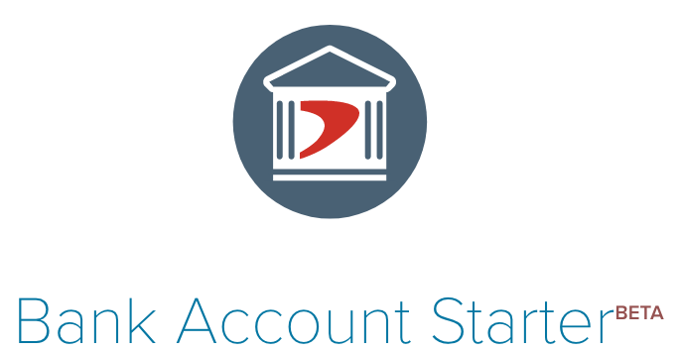
Consumer-Focused API Products
Our APIs have been helping our internal teams create some of the most innovative banking and financial services experiences inside Capital One. By opening our platform, we have put developers in the co-pilot seat –
enabling new and emerging business models for their innovations.
Based on balances and redemption options, developers can tailor
the experience
Get a list of Capital One credit card offers or pre-qualified with a few pieces of
personal info
Securely open a Capital One account with no fees, no minimums, and no catches

Slide 6
Credit Card Offers API
Get up to date information on miles, points or cash rewards on Capital One cards.
Within 60 seconds of submitting a few pieces of identifying information through a secure channel, a customer is treated to a list of personalized credit card offers.
Companies can match their customers to credit offer products that better suit their needs and are more likely to result in an approved application.

Slide 7
Rewards API
Access to Capital One rewards balance, type and conversion rates in context of an app or experience.
For rewards aggregators and eCommerce sites, the Capital One Rewards API is the only secure and approved manner to help a customer access and track their Capital One Rewards account balance.
Sites and apps can leverage this data to improve engagement by allowing customers to set savings goals and helping them to make informed shopping decisions.

Slide 8

Bank Account Starter API
Developers can design an experience where users can open and fund a new account without ever visiting a branch.
Our Bank Account Starter API give customers the ability to securely open a Capital One 360 Savings or Money Market account with no fees, no minimums, and no catches.
Companies can create a seamless user experience for their customers, who can open the account and transfer the initial funds without ever leaving the site.

Slide 9
Digital Identity Products (Invite Only)
We’re making our Identity Verification APIs available to selected business partners as part of this new, limited beta program.
Online identity fraud continues to grow across every channel and touchpoint of the end-to-end customer engagement cycle. At Capital One, we understand that access to trusted identity information is not only critical to managing our business across the customer lifecycle – it's critical to digital commerce and the economy at large.
That’s why we're excited to partner with selected businesses to test a new line of Digital Identity Products that balance a simple, elegant user experience with advanced identity capabilities.

Slide 10

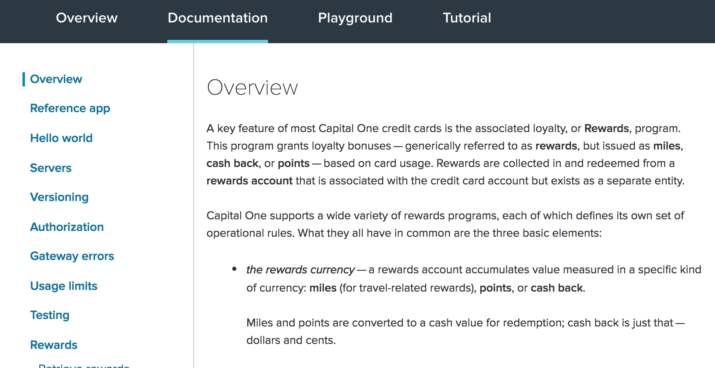
Comprehensive Documentation
Thoughtful, thorough documentation is a vital component of our APIs.
Our team of writers works closely with our product and tech teams to provide clear and
concise guides specifically for our primary audience – developers.

Slide 11
Live Demo

Slide 12


Join the Conversation
Follow us on twitter @CapitalOneDevEx
You can also find us on:
Medium.com/capital-one-developers
Developer.CapitalOne.com/blogs/
Capital One DevExchange on Spotify

